Slide 1


Implementing Transfer Learning Techniques
Notes:
Hello and welcome to this first presentation in the Practicum AI Convolutional Neural Networks workshop series. I’m Dan Maxwell, and I will act as your guide and mentor for this learning experience. I currently work as an AI Trainer / Consultant in the Research Computing Department at the University of Florida.
So, let’s get started…

Slide 2
Implementing Transfer Learning Techniques - Objectives
Understand Feature extraction.
Understand Fine-tuning.
Understand LoRA.
And compare/contrast these strategies.

Slide 3
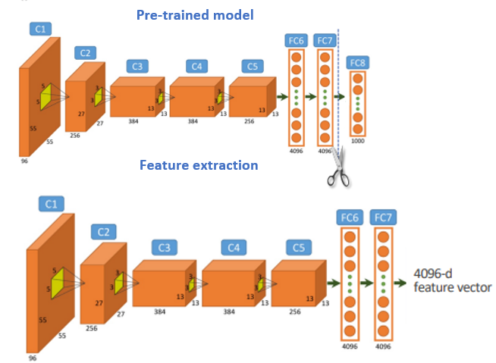
What is Feature Extraction?
Source: A Study Review: Semantic segmentation with Deep Neural-Networks-Aydin-Ayanzadeh
Notes:
Uses a pre-trained model to extract meaningful features without retraining the base model.
Leverages learned representations (e.g., from ImageNet) for a new task.
Beneficial for smaller datasets; uses established feature hierarchies.
Common in CV: Early layers (edges, textures) are frozen; only a new classifier head is trained.
“Feature extraction is particularly useful when the target task has a small dataset or when computational resources are limited. Specifically, if the target task dataset is similar to the source task dataset you should perform a training on the pre-trained model features from higher layers (detailed features). Otherwise, if the dataset is very different from the original dataset, then you should perform a training on the features extracted from lower layers (general features). A possible limit is overfitting, which can occurs if the amount of new data is particularly limited. On the other side, it is computationally less expensive than fine tuning as it requires training only for the added layers, which generally have fewer parameters than the pre-trained layers.”
[[https://medium.com/data-reply-it-datatech/transfer-learning-feature-extraction-and-fine-tuning-db7d82767992]]

Slide 4
Feature Extraction Workflow
Select Pre-Trained Model (e.g., ResNet, EfficientNet, BLIP). Closeness to target task/domain helps.
Load Model (with pre-trained weights).
Freeze Early/Base Layers.
Modify/Replace Output Layer(s) for the target task/classes.
Preprocess Data (match model's expected input format).
Extract Features (pass data through frozen layers).
Train Only the New Output Layers using extracted features.
Evaluate and Optimize.
Notes:
Select Pre-Trained Model (e.g., ResNet, EfficientNet, BLIP). Closeness to target task/domain helps.
Load Model (with pre-trained weights).
Freeze Early/Base Layers.
Modify/Replace Output Layer(s) for the target task/classes.
Preprocess Data (match model's expected input format).
Extract Features (pass data through frozen layers).
Train Only the New Output Layers using extracted features.
Evaluate and Optimize.

Slide 5
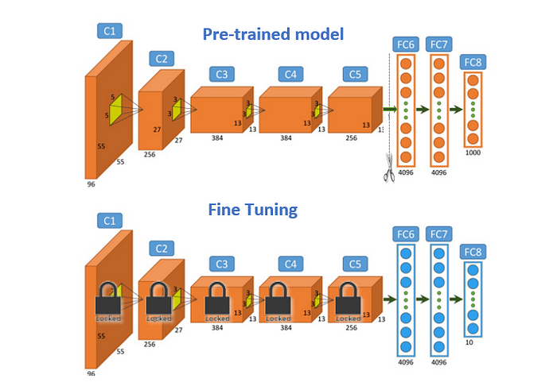
What is Fine-Tuning?
Source: Deep learning models and traditional automated techniques for brain tumor segmentation in MRI: a review-Parvathy Jyothi & A. Robert Singh
Notes:
Learning Rate – The amount numerical amount that parameter weights are adjusted during backpropagation.
Batch Size – How many samples are viewed at once while training.
Regularization – Methods used to prevent overfitting and improve generalization of a model.
Optimizer – The algorithm that is used in conjunction with the loss function to find optimal parameters.
Epochs – The number of full training passes a model undergoes.
Frozen Layers – Layers of a pre-trained model that are locked, or frozen, during the retraining process to preserve the patterns they’ve learned.

Slide 6
Fine-Tuning Workflow
Select Pre-Trained Model.
Load Model (with pre-trained weights).
Determine Layers to Unfreeze (based on task similarity).
Modify Output Layers.
Adjust Learning Rates (Lower LR for pre-trained layers, higher for new layers is common).
Preprocess Data.
Train the (Partially) Unfrozen Model (monitor validation loss).
Evaluate and Optimize.
Notes:
Select Pre-Trained Model.
Load Model (with pre-trained weights).
Determine Layers to Unfreeze (based on task similarity).
Modify Output Layers.
Adjust Learning Rates (Lower LR for pre-trained layers, higher for new layers is common).
Preprocess Data.
Train the (Partially) Unfrozen Model (monitor validation loss).
Evaluate and Optimize.

Slide 7
Quick Quiz!
Question 1: In which scenario is Feature Extraction generally preferred over Fine-tuning
When the target dataset is very large and very different from the source dataset.
When you have limited computational resources and the target task is similar to the source task.
When you need the model to learn completely new low-level features.
When you want to update all layers of the pre-trained model.
Answer: B
Notes:
A) When the target dataset is very large and very different from the source dataset. B) When you have limited computational resources and the target task is similar to the source task. C) When you need the model to learn completely new low-level features. D) When you want to update all layers of the pre-trained model.

Slide 8
Quick Quiz!
Question 2: What is a key difference in the workflow between Fine-tuning and Feature Extraction?
Only Fine-tuning requires selecting a pre-trained model.
Only Feature Extraction requires modifying the output layer.
Feature Extraction uses higher learning rates than Fine-tuning.
Fine-tuning involves unfreezing and retraining some base layers, while Feature Extraction keeps them frozen.
Answer: D
Notes:
A) Only Fine-tuning requires selecting a pre-trained model. B) Fine-tuning involves unfreezing and retraining some base layers, while Feature Extraction keeps them frozen. C) Only Feature Extraction requires modifying the output layer. D) Feature Extraction uses higher learning rates than Fine-tuning.

Slide 9
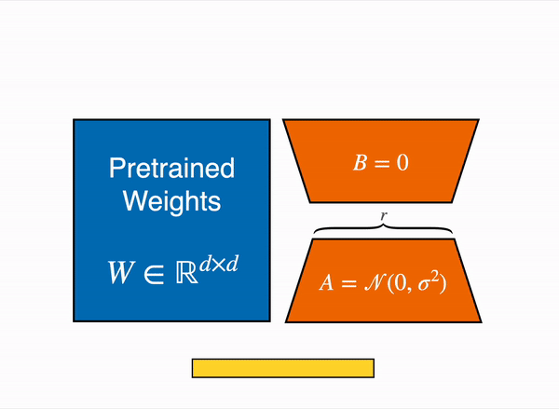
What is LoRA?
Source: https://huggingface.co/blog/samuellimabraz/peft-methods
Notes:
A parameter-efficient fine-tuning (PEFT) technique.
Adapts models by introducing small, trainable low-rank updates to specific layers.
Modifies only a subset of parameters -> reduces computational cost & memory.
Maintains performance comparable to full fine-tuning in many cases.

Slide 10
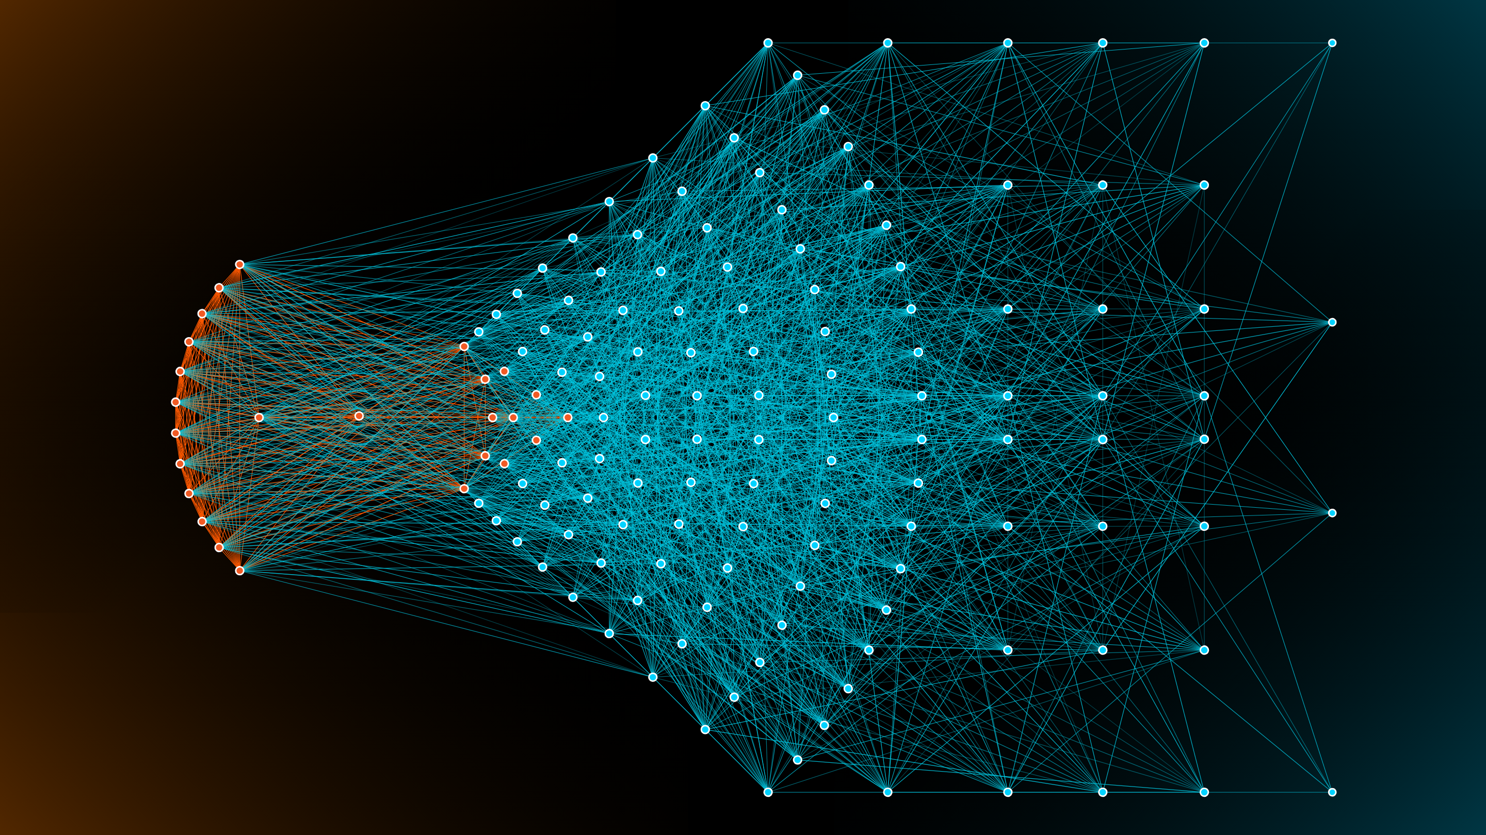
When is LoRA Most Effective?
Source: https://medium.com/@stephy.SD99/what-is-a-neural-network-4647c8f25fd3
Notes:
Best for large models with many parameters, especially attention-based ones.
Examples: Transformer-based models (BERT, GPT, T5).
Vision Transformers (ViTs).
Multimodal Models (like BLIP).

Slide 11
LoRA Workflow
Select Pre-Trained Model
Identify Target Layers for LoRA (Often attention layers).
Apply LoRA Adaptation
Preprocess Data.
Train the Model with LoRA
Evaluate and Optimize (Tune LoRA rank 'r', alpha 'α').
Notes:
Select Pre-Trained Model.
Load Model (with pre-trained weights).
Determine Layers to Unfreeze (based on task similarity).
Modify Output Layers.
Adjust Learning Rates (Lower LR for pre-trained layers, higher for new layers is common).
Preprocess Data.
Train the (Partially) Unfrozen Model (monitor validation loss).
Evaluate and Optimize.

Slide 12
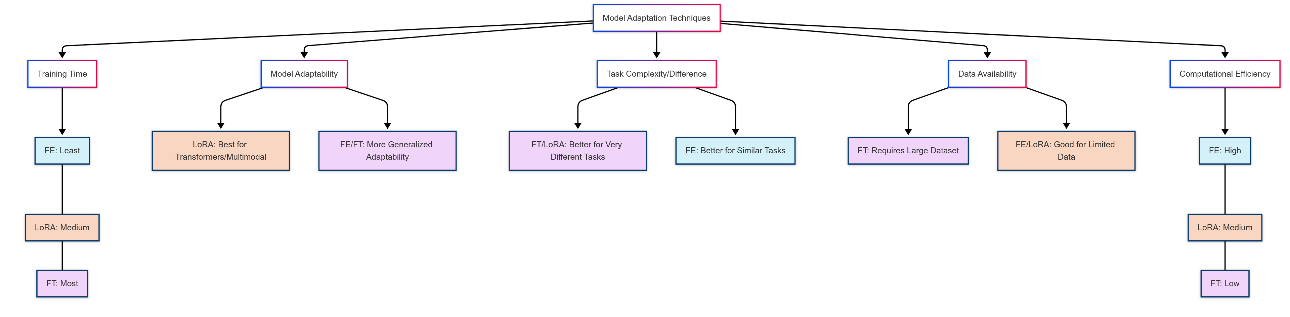
Choosing Your Strategy: Key Factors
Notes:
Computational Efficiency: FE (High) > LoRA > FT (Low).
Data Availability: FT (Large data best) vs. FE/LoRA (Good for limited data).
Task Complexity/Difference: FT/LoRA better if target task is very different.
Model Adaptability: LoRA best for Transformers/Multimodal; FE/FT more general.
Training Time: FE (Least) < LoRA / FT (More)

Slide 13
Quick Quiz!
Question 1: If you have a very large target dataset quite different from the source data, and sufficient compute resources, which technique is likely MOST flexible for adapting the model?
Fine-tuning
LoRA
Feature Extraction
Domain Adaptation
Answer: A
Notes:
Fine-tuning
LoRA
Feature Extraction
Domain Adaptation

Slide 14
Implementation Exercise!!!
Notes:
Freeze all layers.
Freeze only the last layer.
Unfreeze only the first few layers.
Unfreeze most or all layers.

Slide 15
Neural Network Neurons

Slide 16
Module 2 Objectives
Describe the basis of a neural network (neuron).
Identify and describe an artificial neuron (perceptron).
Discuss bias and weights.
Describe and identify activation functions.
Describe and simulate image processing in a small neural network.
Implement and train a perceptron using TensorFlow.

